Slide 1
Quiz on Lecture 5
Please receive the quiz handout from Cyrille, Oliver, Vincent, Jan
Complete the quiz in silence
Hand the quiz back

Slide 2
Quiz on Lecture 5
What is not true about building interfaces for ML models?
  They are useful for allowing non-developers to interact with models
  They are helpful for debugging and user feedback
  They make the model more explainable to end users
  They can help showcase prototypes to stakeholders
Which of these is NOT a reason developers choose Streamlit or Gradio for ML interfaces?
  Easy to use with Python
  Built-in support for model training
  Quick to prototype interactive demos
  Minimal boilerplate code
Which of the following is true when comparing Streamlit and Gradio?
  Streamlit offers more flexibility for customizing layouts and integrating charts compared to Gradio.
  Gradio supports more advanced layout configurations out-of-the-box than Streamlit.
  Gradio requires a frontend framework like React to customize its layout.
  Streamlit does not support file uploads
How do you provide multiple input components, such as a textbox and a slider, to a gr.Interface
  inputs=gr.Textbox() + gr.Slider()
  inputs=("text", "slider")
  inputs={"name": gr.Textbox(), "value": gr.Slider()}
  inputs=[gr.Textbox(), gr.Slider()]
How can you create a temporary, shareable public link for your Gradio app when you launch it?
  demo.launch(remote=True)
  demo.launch(network_access=True)
  demo.launch(public=True)
  demo.launch(share=True)

Slide 3
Quiz on Lecture 5 (Answers)
What is not true about building interfaces for ML models?
  They are useful for allowing non-developers to interact with models
  They are helpful for debugging and user feedback
  They make the model more explainable to end users
  They can help showcase prototypes to stakeholders
Which of these is NOT a reason developers choose Streamlit or Gradio for ML interfaces?
  Easy to use with Python
  Built-in support for model training
  Quick to prototype interactive demos
  Minimal boilerplate code
Which of the following is true when comparing Streamlit and Gradio?
  Streamlit offers more flexibility for customizing layouts and integrating charts compared to Gradio.
  Gradio supports more advanced layout configurations out-of-the-box than Streamlit.
  Gradio requires a frontend framework like React to customize its layout.
  Streamlit does not support file uploads
How do you provide multiple input components, such as a textbox and a slider, to a gr.Interface
  inputs=gr.Textbox() + gr.Slider()
  inputs=("text", "slider")
  inputs={"name": gr.Textbox(), "value": gr.Slider()}
  inputs=[gr.Textbox(), gr.Slider()]
How can you create a temporary, shareable public link for your Gradio app when you launch it?
  demo.launch(remote=True)
  demo.launch(network_access=True)
  demo.launch(public=True)
  demo.launch(share=True)

Slide 4
Assignment 1 — (almost randomly) selected submissions
Text: https://aims-course-service-danielayomide-git-186773437176.europe-west2.run.app/
Image: https://aims-course-service-0xayman-186773437176.europe-west2.run.app
Text: https://aims-course-service-mohammed-nagi-186773437176.europe-west2.run.app
Text: https://aims-course-service-dagmaros27-186773437176.europe-west2.run.app/

Slide 5
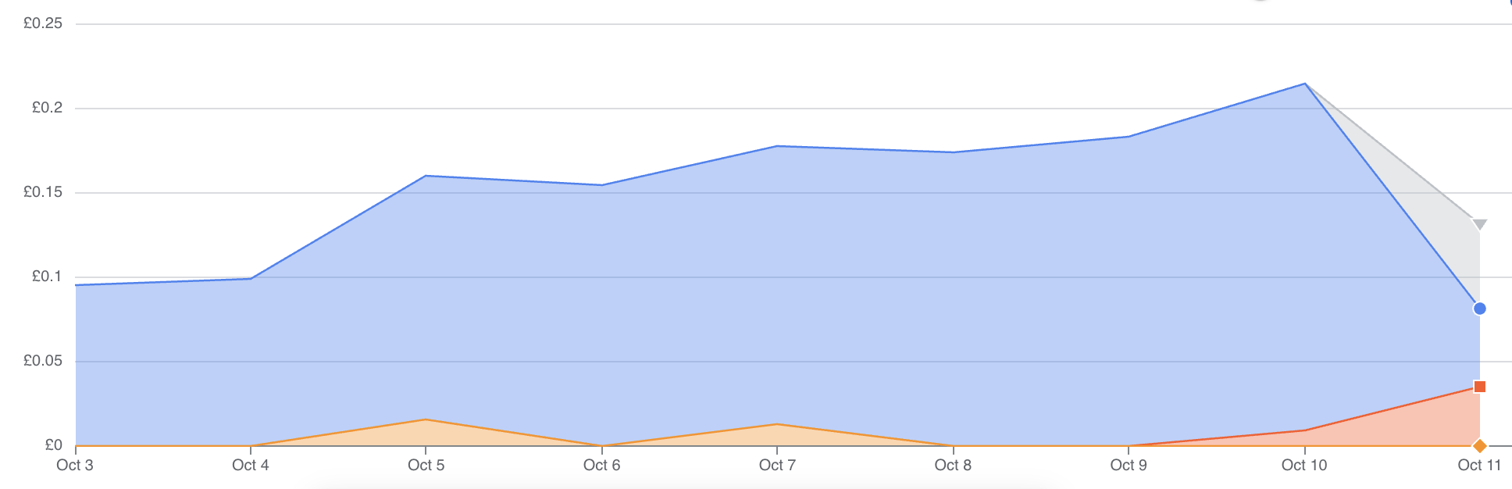
GCP costs for all students
Blue = Google Container Registry
Yellow = Gemini API key
Red = Google Cloud Run

Slide 6
Designing and Deploying
end-to-end
Production Grade ML Applications
Lecture 6: Data Engineering — Foundation & Building Blocks
October 2025
Oliver Angélil & Vincent Frimpong

Slide 7
Contents of three Data Engineering Lectures:
Lecture 6: Foundation and Building Blocks
  What is Data Engineering (DE)?
  The DE lifecycle
  Types of Data Architectures
  On-Prem vs Cloud (IaaS vs PaaS vs SaaS)
  Infrastructure as Code (IaC)
Lecture 7: The DE Lifecycle in Depth
  Source Systems & Storage
  Ingestion
  Modeling, and Transformation
  Serving Data for Analytics, Machine Learning, and Reverse ETL
Lecture 8: Learning by Doing — Building your own DE Pipeline with Dagster
this lecture
Oliver

Slide 8
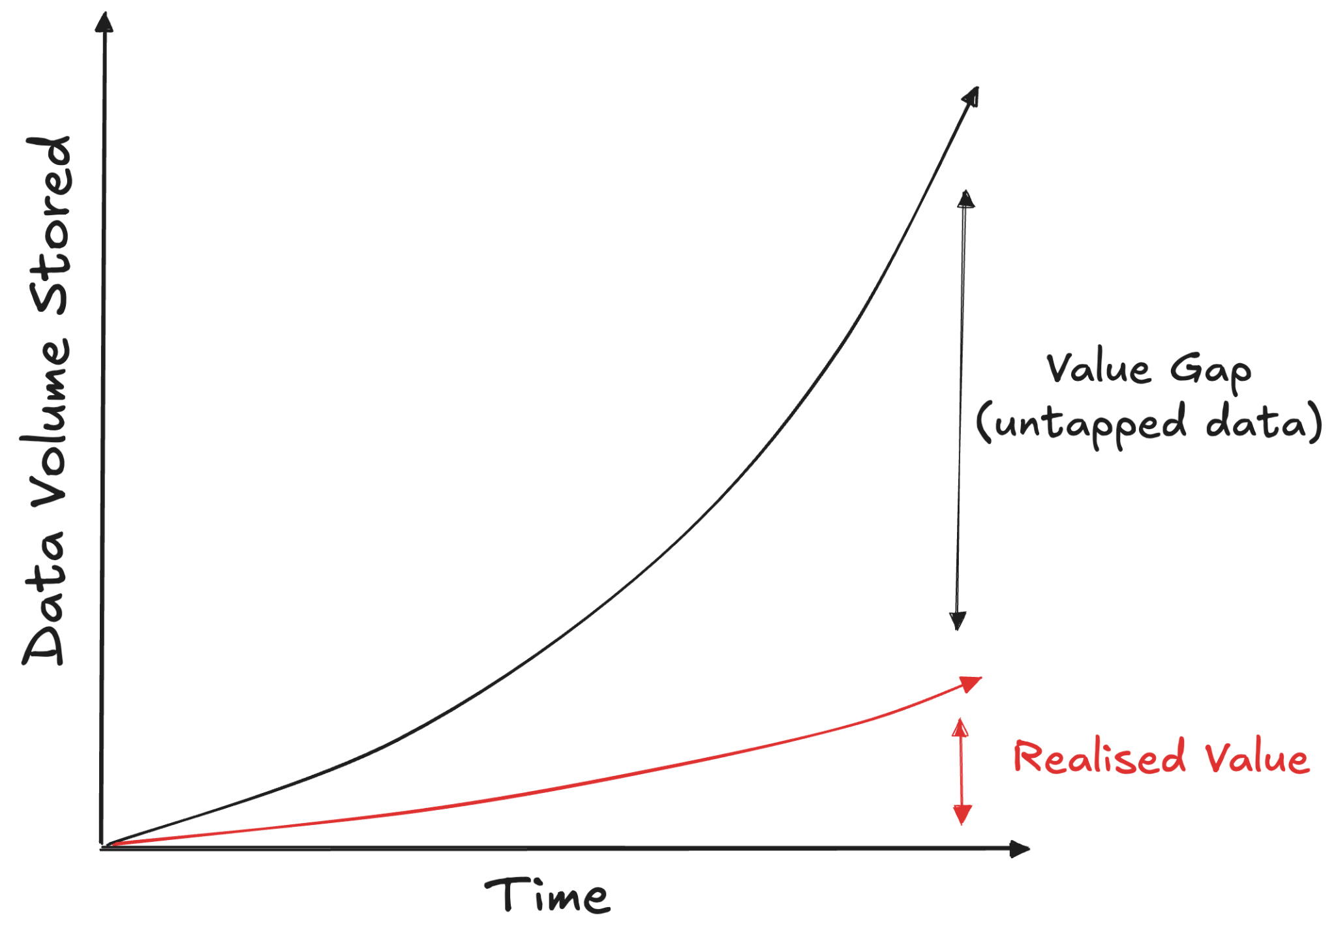
1.1 What is Data Engineering? The Problem (Why?)
Oliver

Slide 9
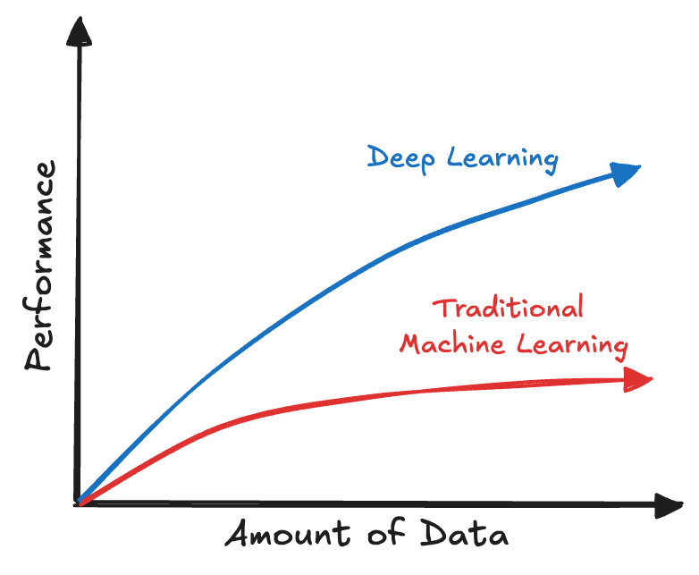
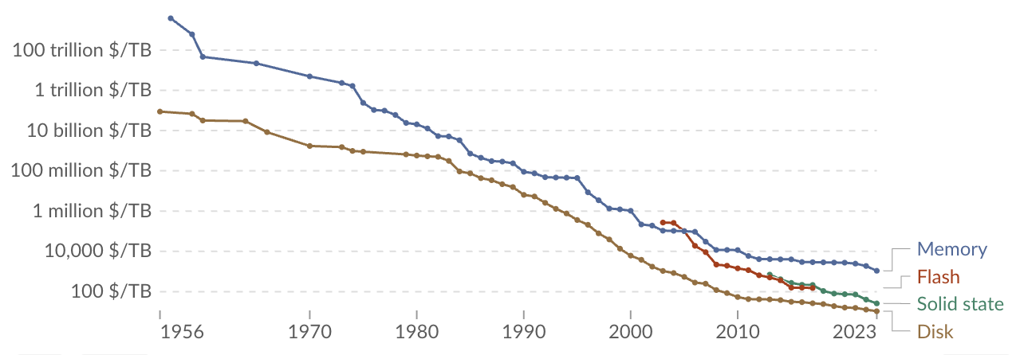
1.1 What is Data Engineering? The Problem (Why?)
Why do companies store more & more data?
the realisation that data is an asset that has the potential to drive a competitive edge
the expansion of IoT devices that capture streams of data
the nature of Deep Learning architectures that enable their predictive performance to increase as a function of the size of the datasets they are trained on [*1]
the fact that the cost of data storage has decreased exponentially from the 1950s to now [*2]
[*1]
[*2]
Oliver

Slide 10
1.1 What is Data Engineering? Definition (What?)
"Data engineering is the development, implementation, and maintenance of the systems and processes that take in raw data and produce high-quality, consistent information that supports downstream use cases, such as analysis and machine learning."
Oliver

Slide 11
1.1 What is Data Engineering? History
1970s: IBM develops Structured Query Language (SQL) & Relational DB
1980s: Bill Inmon coins the term data warehouse — central monolithic repositories of data integrated from disparate sources to support Business Intelligence (BI)
1990s: Internet goes mainstream — web applications produce large volumes of data. Companies continue to rely on monolithic relational DBs in data warehouses.
2000s:
  Data systems are updated to handle more data: CPUs, RAM, Hard Disks become much cheaper -> distributed computation and storage on compute clusters.
  2004: Google develops Map Reduce; 2006: Yahoo develops Hadoop; 2008: Amazon releases EC2 & S3
2010s:
  Rise of the "big data" era and Infrastructure as a Service (IaaS) -> Cloud Services
  Shift towards simplification & abstraction with off-the-shelf products and high quality open-source software, to make big data processing accessible to anyone.
Oliver

Slide 12
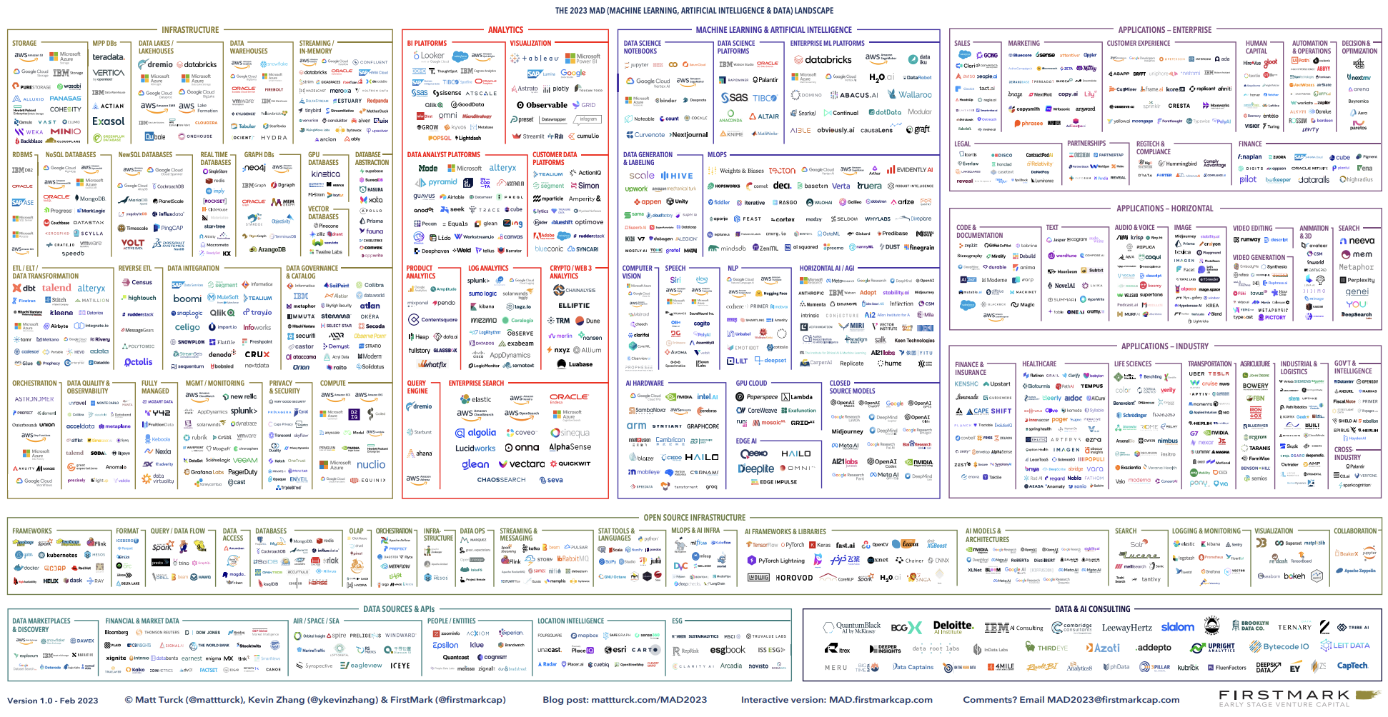
1.1 What is Data Engineering? History
2020s:
  Shift to decentralized and abstracted tools to help in the data management process.
  Simpler to use, but much more choice!
Oliver

Slide 13
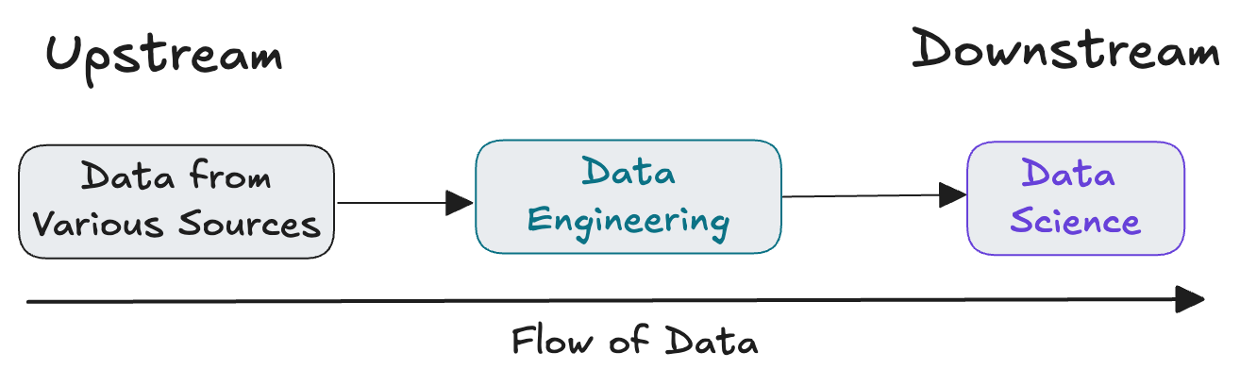
1.1 What is Data Engineering? DE vs DS
Data Engineers provide inputs for Data Scientists, who convert these inputs into something useful for a company
Oliver

Slide 14
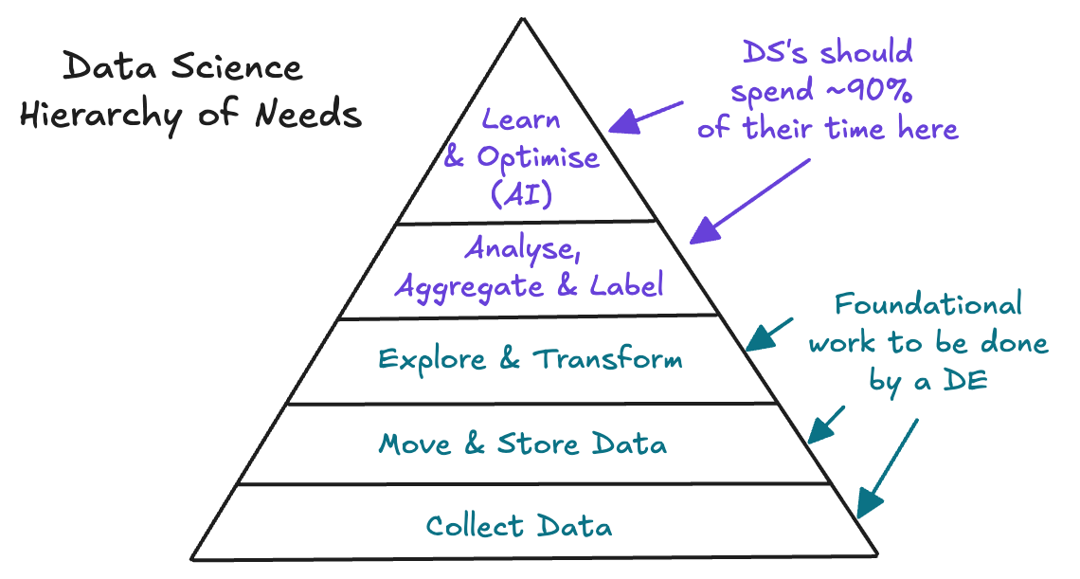
1.1 What is Data Engineering? The DS hype...
In the 2010s, companies hired too many DSs relative to DEs
DS spent ~70-80% of their time on DE tasks...
Many DS projects fail because companies don't invest enough in the base of the pyramid
Oliver

Slide 15
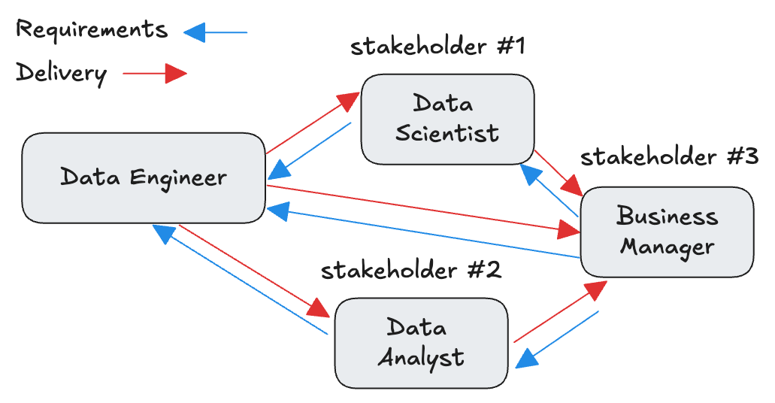
1.1 What is Data Engineering? Skills required
Communication with technical and non-technical stakeholders is key.
Stakeholders define requirements to be delivered
Oliver

Slide 16
1.1 What is Data Engineering? Skills required
Bad Data Engineers/Scientists:
  Focus on outputs not outcomes: deliver work without understanding if they generate value
  Want to apply the latest and greatest tools & AI to everything
  Over-engineer solutions: build complex solutions even when simpler ones would do
  Are resistant to feedback: defend their work even when presented with evidence
Good Data Engineers/Scientists:
  Are self-motivated and independent (e.g. do not wait for someone more senior to give them tasks)
  Zoom out to understand the big picture and the broader goals
  Understands problems and solves them with or without AI
  Favour simple solutions over complex ones
  Can tell the difference between disruptive and hyped technologies
Oliver

Slide 17
1.1 What is Data Engineering? Skills required
Can design solutions that are cost optimized, in all areas of the DE lifecycle:
  Source Systems
  Storage
  Ingestion
  Transformation
  Serving
Should a DE know how to code?
  Absolutely: SQL; Python; bash.
  Bonus: Scala & Rust
Oliver

Slide 18
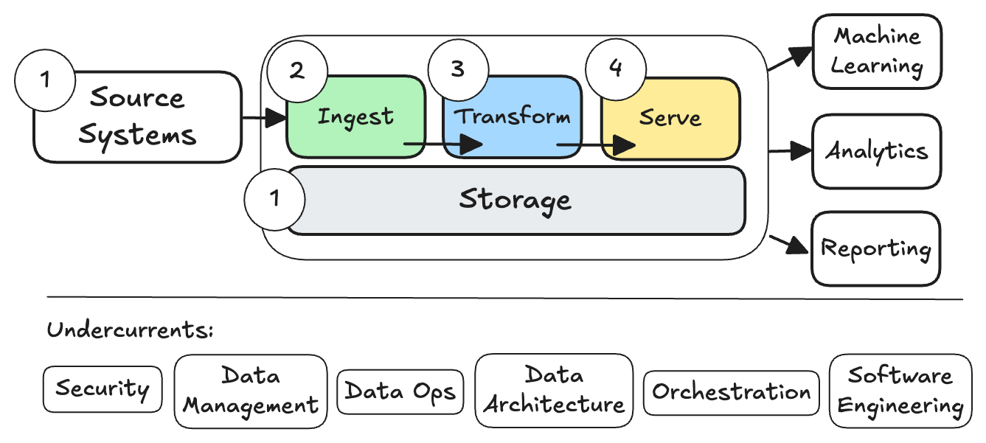
1.2 The DE Lifecycle: What is the DE Lifecycle?
refer to Fundamentals of Data Engineering (2022) for more info on Undercurrents
Oliver

Slide 19
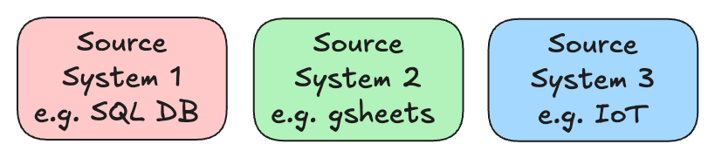
1.2 The DE Lifecycle: 1 — Source Systems & Storage
Starting point of any data project, and any data conversation: "what data do you have and where can I find it?"
Silos of data from different teams with their "own conventions", result in:
  Inconsistent data formats; naming conventions; etc
  Lack of cleanliness / data quality
  Duplicate data
  Governance difficulty — challenging to have holistic oversight
  Does not accommodate self-service of data (i.e. different mechanisms to access data)
Oliver

Slide 20
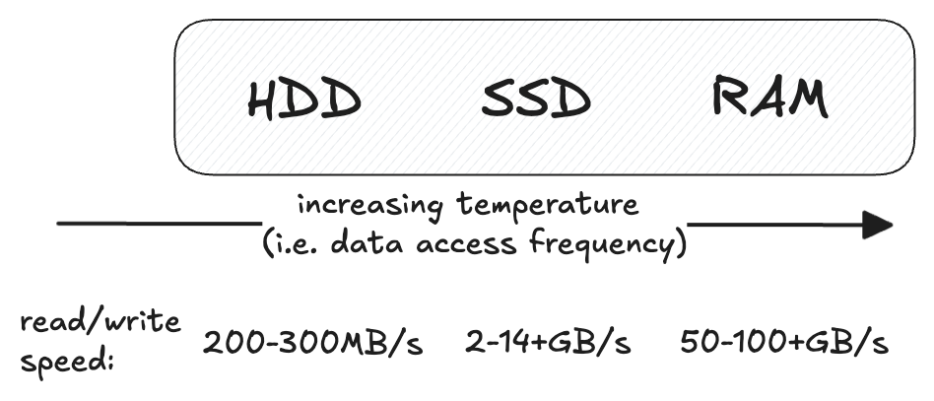
1.2 The DE Lifecycle: 2 — Source Systems & Storage
While storage is a stage of the DE lifecycle, it is a requirement for other stages: Ingest, Transform, Serve
Oliver

Slide 21
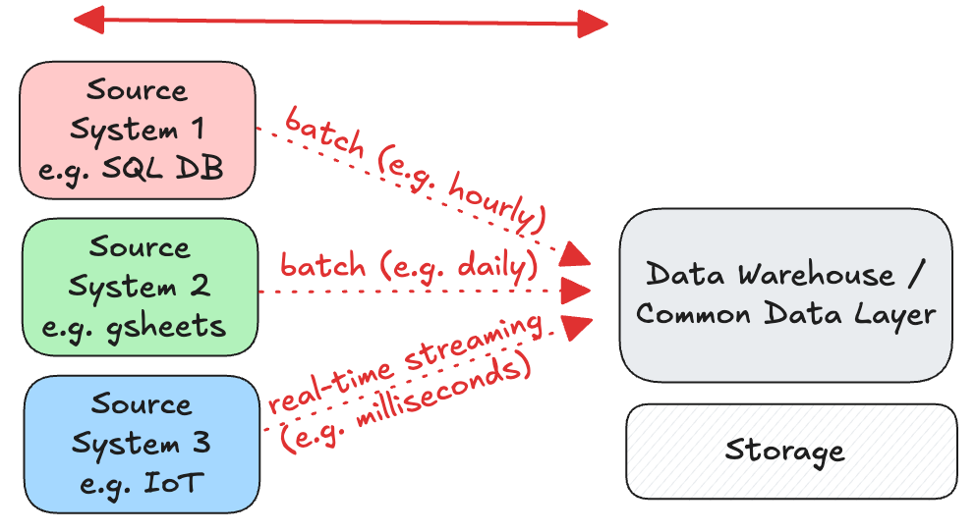
1.2 The DE Lifecycle: 3 — Ingestion
Oliver

Slide 22
1.2 The DE Lifecycle: 4 — Transform
Transforming the data prepares it for reports, analysis, ML
First cleaning is done; and then enrichment (joins), aggregation
Example of cleaning:
Date (STR) | Food Item (STR) | nItems (STR) | Export Country (STR)
2023-01-15 | Applle | 200 | USA
Feb 3, 2023 | Aubergine | 400.0 | United States
30.02.2023 | Eggplant | eighty | Germnay
Raw
Date (DATE) | Food Item (STR) | nItems (INT) | Export Country (STR)
2023-01-15 | Apple | 200 | United States
2023-02-03 | Eggplant | 400 | United States
NULL | Eggplant | 80 | Germany
Clean
(can also choose to remove entire row)
Oliver

Slide 23
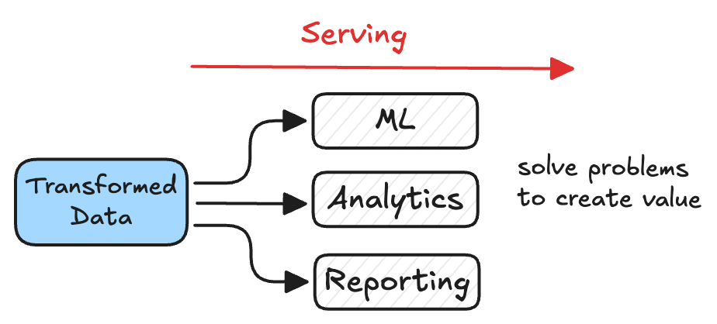
1.2 The DE Lifecycle: 5 — Serve
Storing data does not get value out of it — you have to do something useful with the data
Data has value when it's used for practical purposes
Oliver

Slide 24
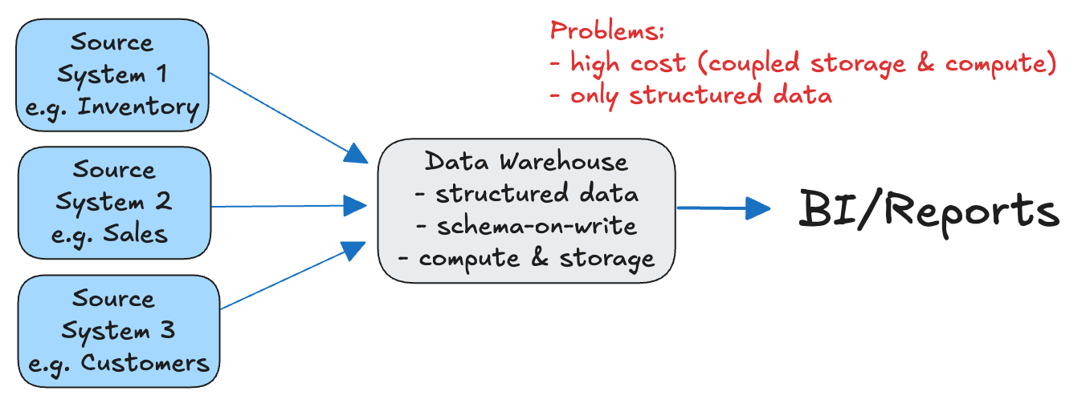
1.3 Types of Data Architecture: Data Warehouse (DW)
Data warehouses (1980s) are central repositories of data integrated from disparate sources.
A system used for reporting and data analysis and is a core component of business intelligence
Coupled compute & storage: DW compute can be used only on its relational storage (i.e. pay for peak usage)
Schema-on-write: the data schema is defined and enforced when data is written into the database
Must be structured (i.e. tabular: columns & rows) data (generally relational DBs)
Vincent

Slide 25
1.3 Types of Data Architecture
"Data architecture is the design of systems to support the evolving data needs of an enterprise, achieved by flexible and reversible decisions reached through a careful evaluation of trade-offs"
A brief history of the main types:
1980s
2010s
2020s
Data Lake +
Data Warehouse
Data Warehouse
Lakehouse
solved
solved
problem=?
problem=?
Vincent

Slide 26
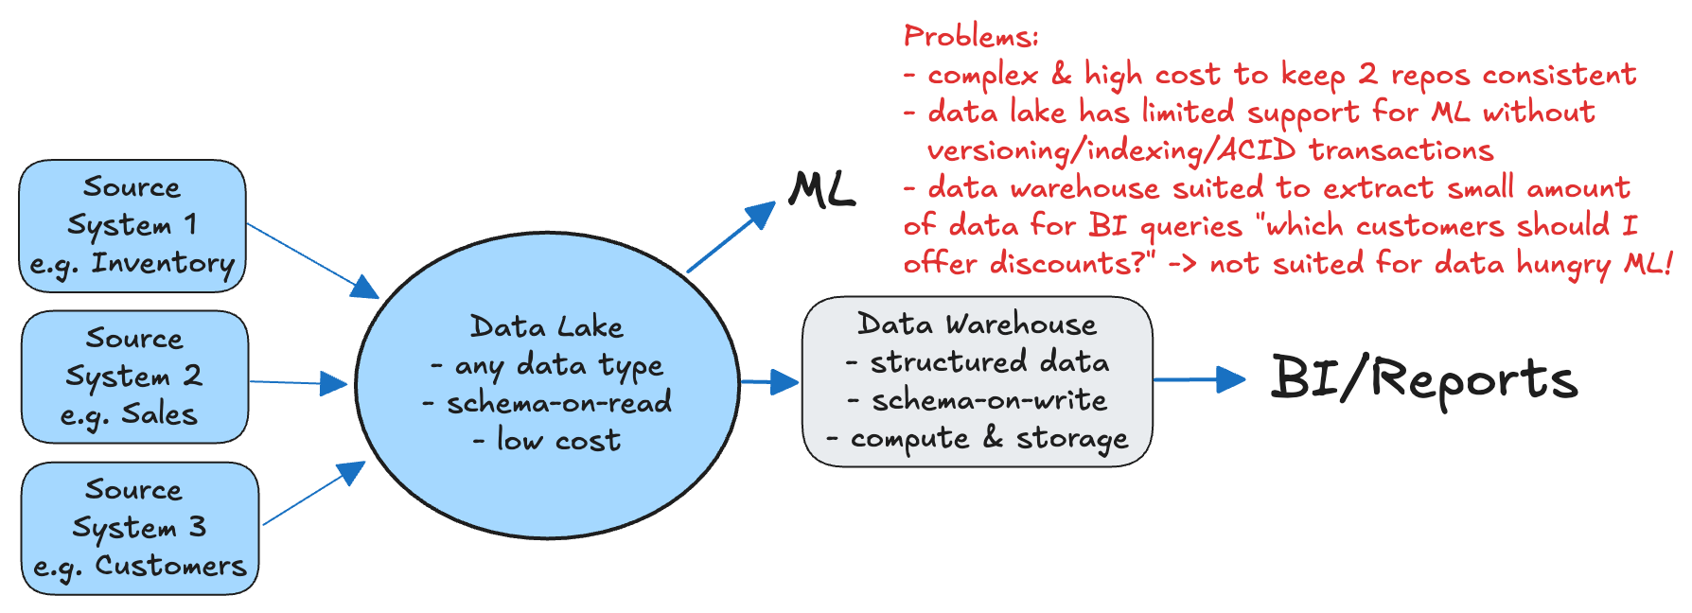
1.3 Types of Data Architecture: Data Lake + DW
Two-tier "modern Data Warehouse" (2010s; used at virtually all Fortune 500 enterprises)
Data Lake for object storage (any type of format — not very different from the filesystem on your laptop)
Data in Data Lake is schema-on-read: schema is applied only when data files are read
Vincent

Slide 27
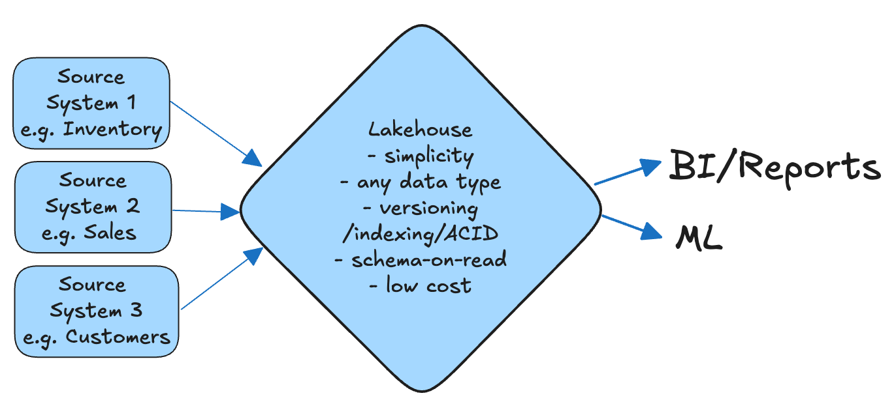
1.3 Types of Data Architecture: Lakehouse
Lakehouse (2020s), pioneered by Databricks in 2021 technical paper
Software layer (e.g. delta-lake; apache iceberg) on top of a data lake
Convergence: best of both a Data Warehouse & Data Lake
Vincent

Slide 28
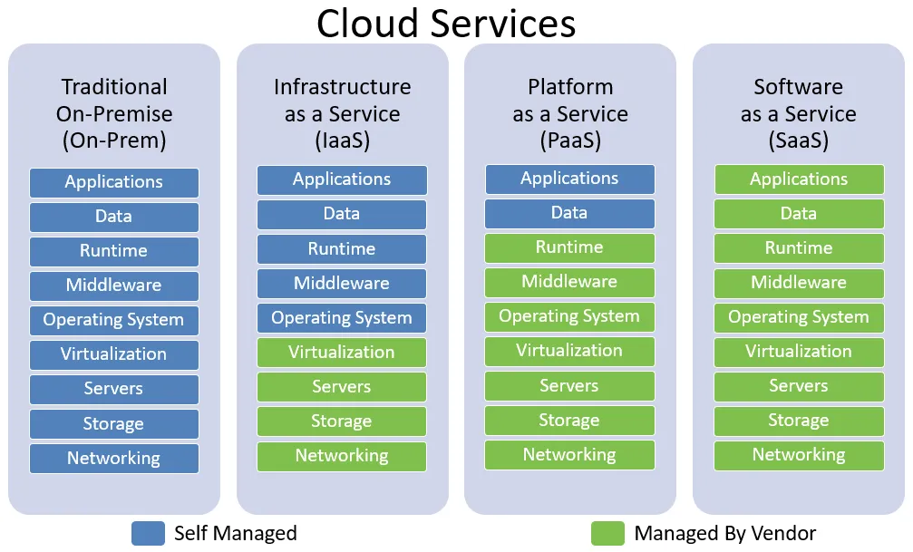
1.4 On-Prem vs Cloud (IaaS vs PaaS vs SaaS)
Examples
IaaS:
- GCP (e.g. GCE; Cloud Storage)
- AWS (e.g. EC2; S3)
- Azure (e.g. VMs, Blob Storage)
- Digital Ocean (e.g. Droplets)
- Hetzner (e.g. Object Storage)
PaaS:
- Google Cloud Run; App Engine
- AWS Elastic Kubernetes Service
- Azure Container Apps
- OpenShift
SaaS:
- Dropbox
- Slack
- Google Workspace (e.g. gdoc, gmail)
- Zoom
Runtime: software environment in which applications execute (e.g. Java Runtime Environment)
Middleware: software acting as bridge between OS & applications (e.g. Nginx, Apache Kafka)
Virtualization: the process of using a hypervisor to run multiple VMs on a single host computer
Vincent

Slide 29
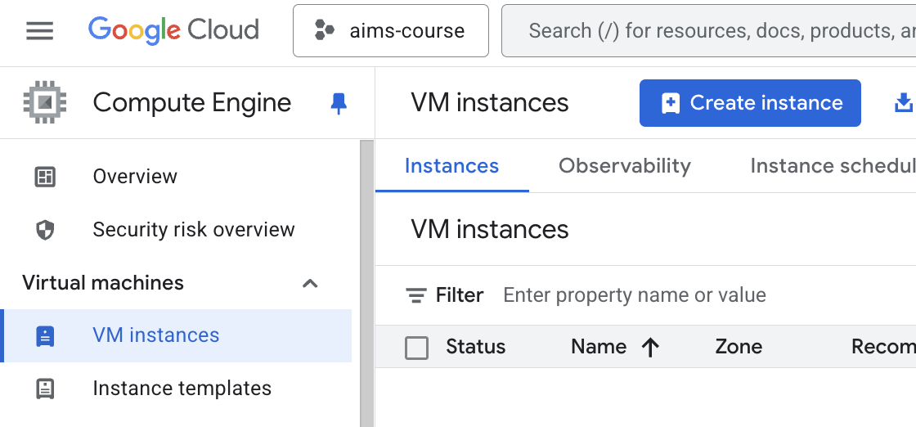
1.5 Infrastructure as Code (IaC)
Definition: Using code to describe & deploy infrastructure
Benefits:
  Disaster Recovery — everything is saved in code and can be re-deployed in a matter of minutes
  Automated — faster deployments
  Consistency & Scalability — for loops can deploy the same Infrastructure (e.g. VMs) many times
  Traceability — can see who made what change and when (everything is tracked through github)
create 1 VM without IaC ("ClickOps")
create 100 VMs with IaC (e.g Terraform / OpenTofu)
resource "google_compute_instance" "vm_instance" {
count = 100
# Each VM will have a unique name like "vm-instance-0", "vm-instance-1", etc.
name = "vm-instance-${count.index}"
machine_type = "e2-medium"
zone = "us-central1-c"
# Define the boot disk for each VM.
# All VMs will be created from the same Debian 11 image.
boot_disk {
initialize_params {
image = "debian-cloud/debian-11"
size = 10 # disk size in GB
}
}
Vincent

